Slide 1
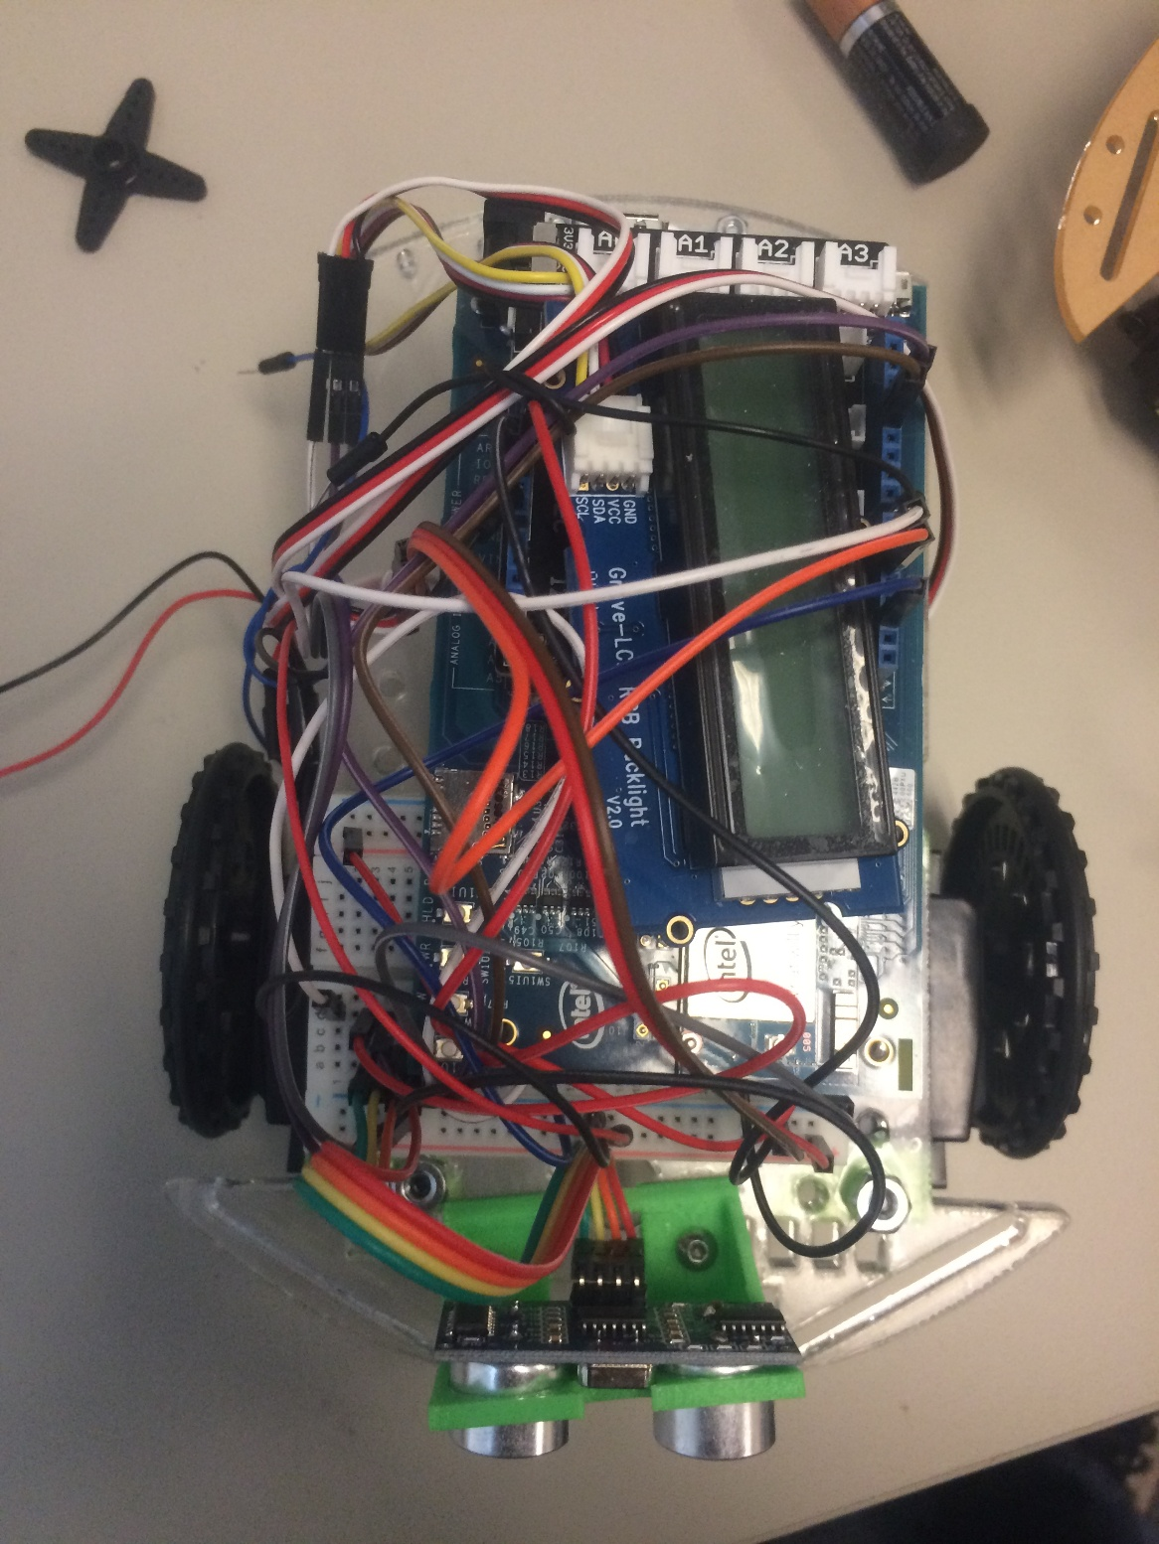
FSE 100
Robot Hardware Assembly Manual
Spring 2016

Slide 2
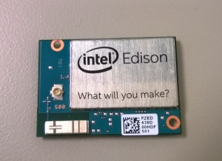
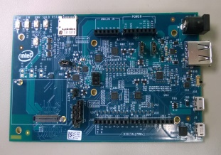
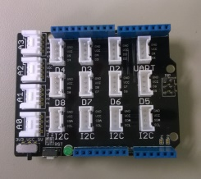
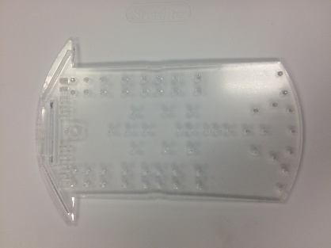
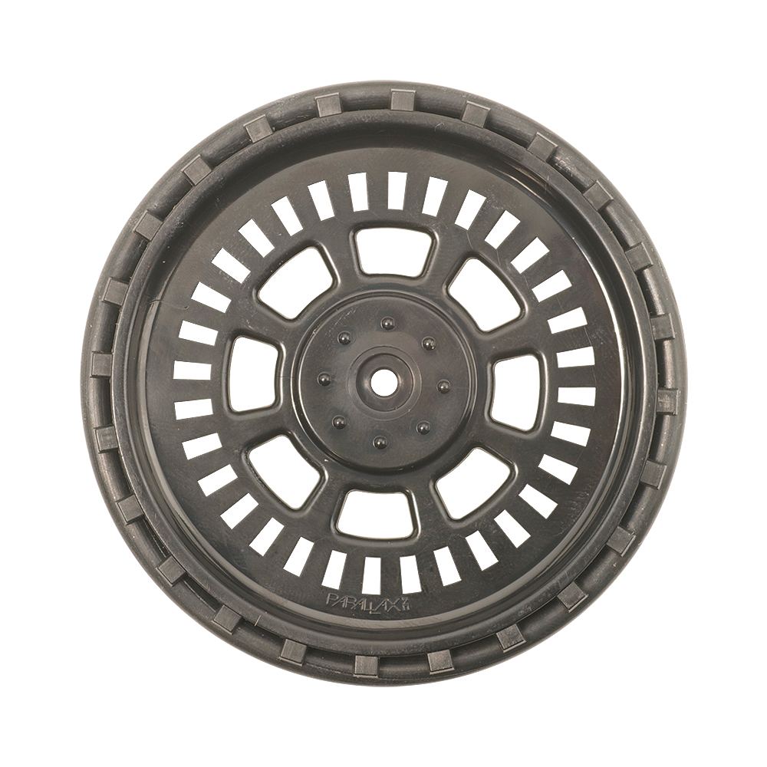
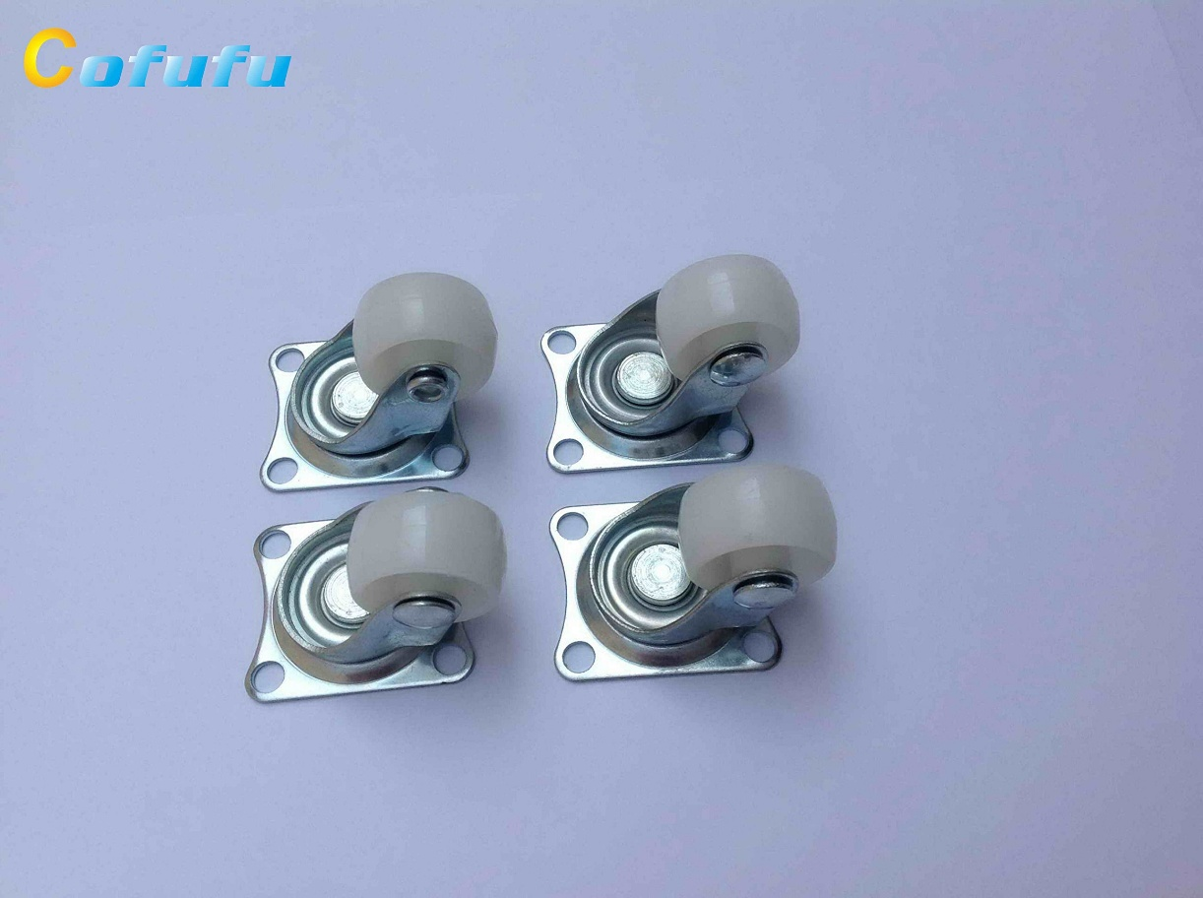
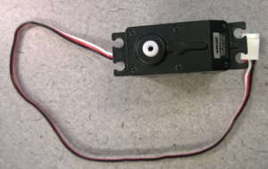
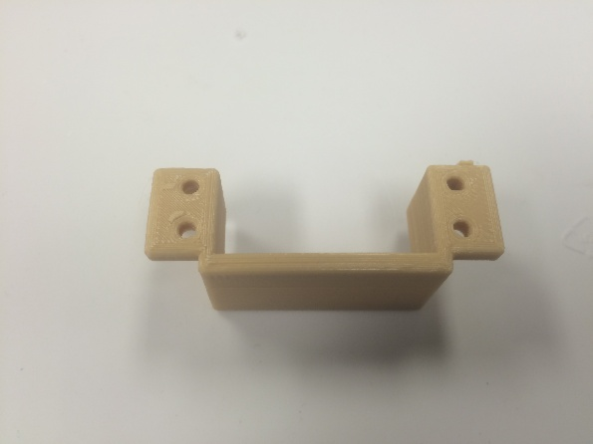
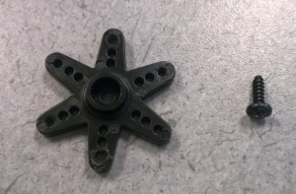
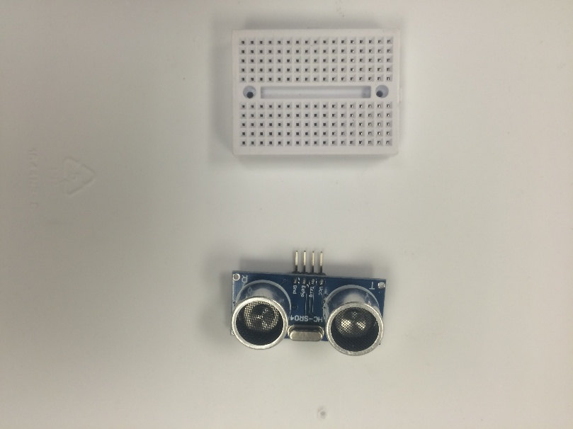
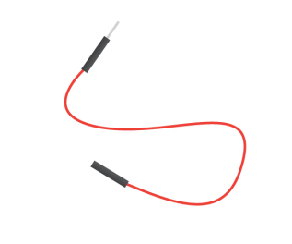
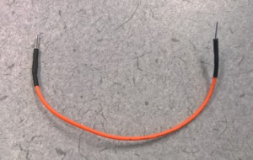
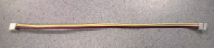
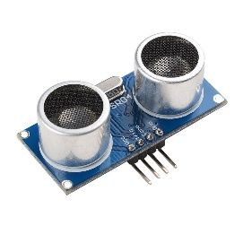
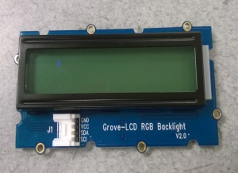
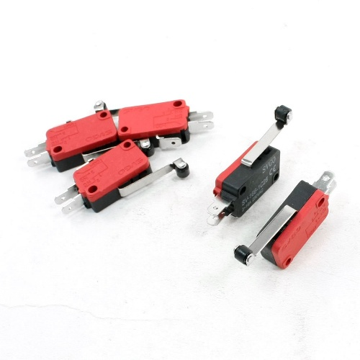
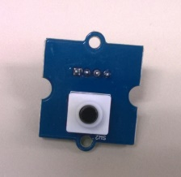
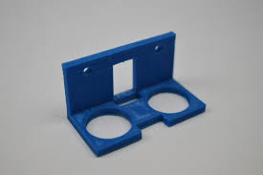
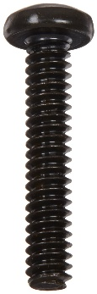
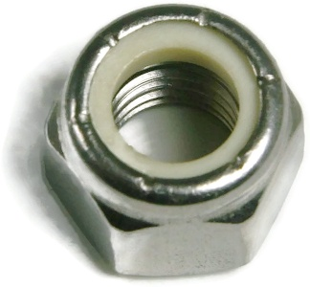
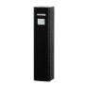
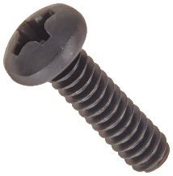
Parts List
1- Intel Edison Board
1- Edison Breakout Board
1- Base Shield
1- Robot Base
2- Wheels + Screws
1- Caster Wheel
2- Servos
2- Servo Mounts
1- Breadboard
LOT -Female Jumpers
LOT- M/F Jumpers
LOT- Male Jumpers
1- Sonar Sensor
1- LCD Screen
1- Touch Sensor
1- Light Sensor
Sonar Mount
LOT- 6-32 ¾ in
LOT- 6-32 Nut
1- Battery Pack
LOT – 6-32 ½ in

Slide 3
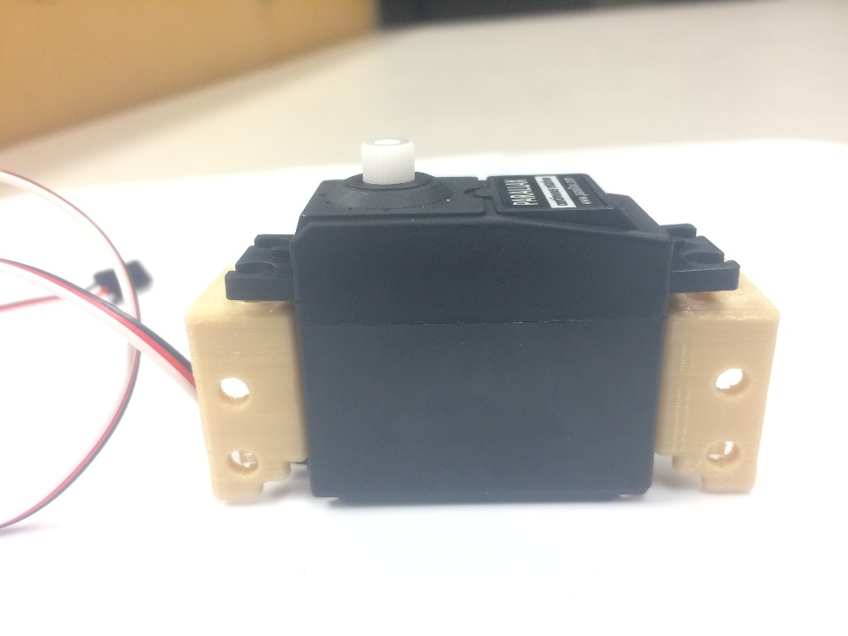
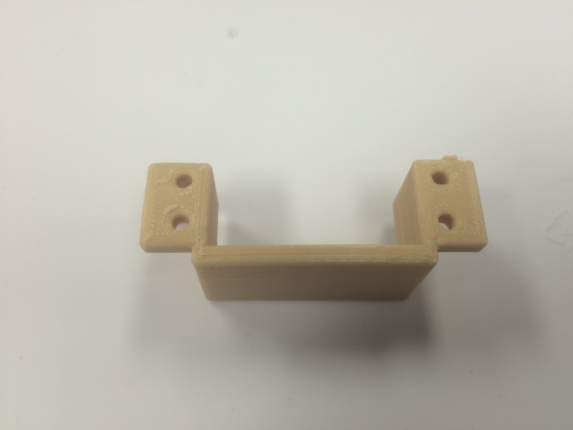
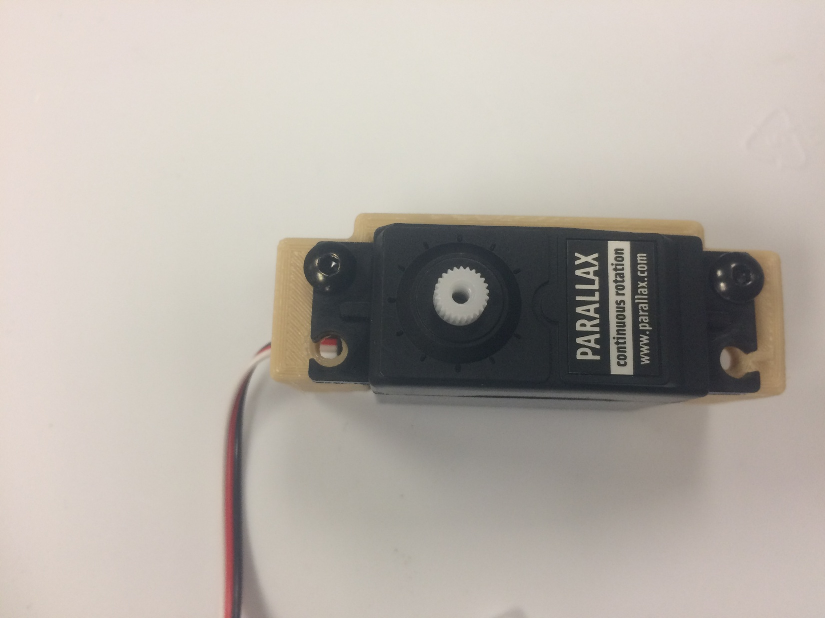
Servo Assembly
Note: Make sure servos are calibrated prior to installation
1. Gather servo and mounts
2. Slide servo into mount
3. Screw in the top hole for the servo

Slide 4
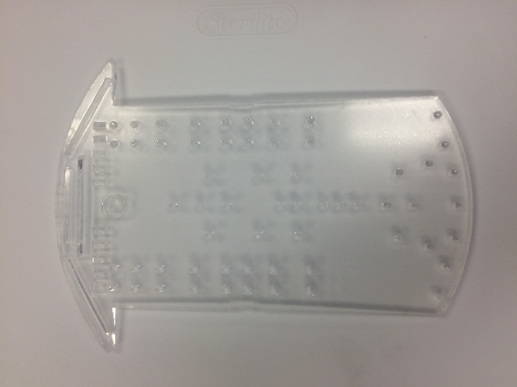
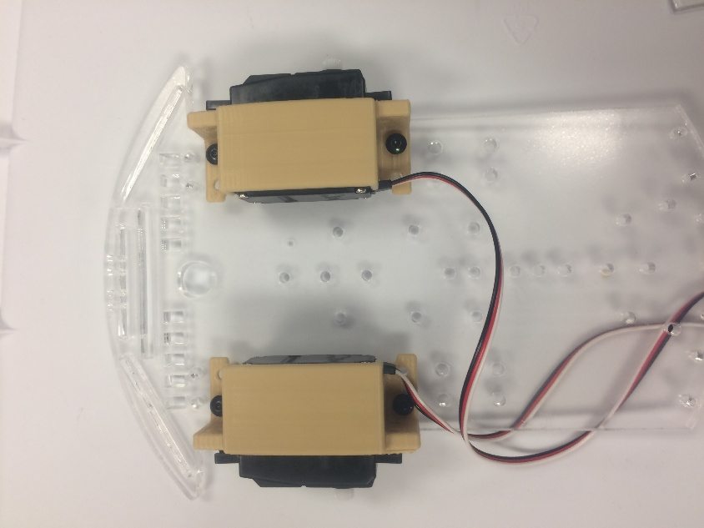

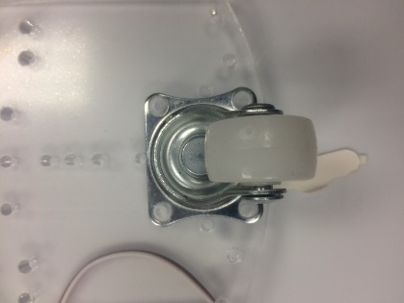
Robot Body Assembly
1. Gather base and Servo mounts
2. Align mounts on the base and
fasten with screw and nuts
3. Gather caster wheel
and hardware
4. Align and fasten Caster
Wheel to base as shown

Slide 5
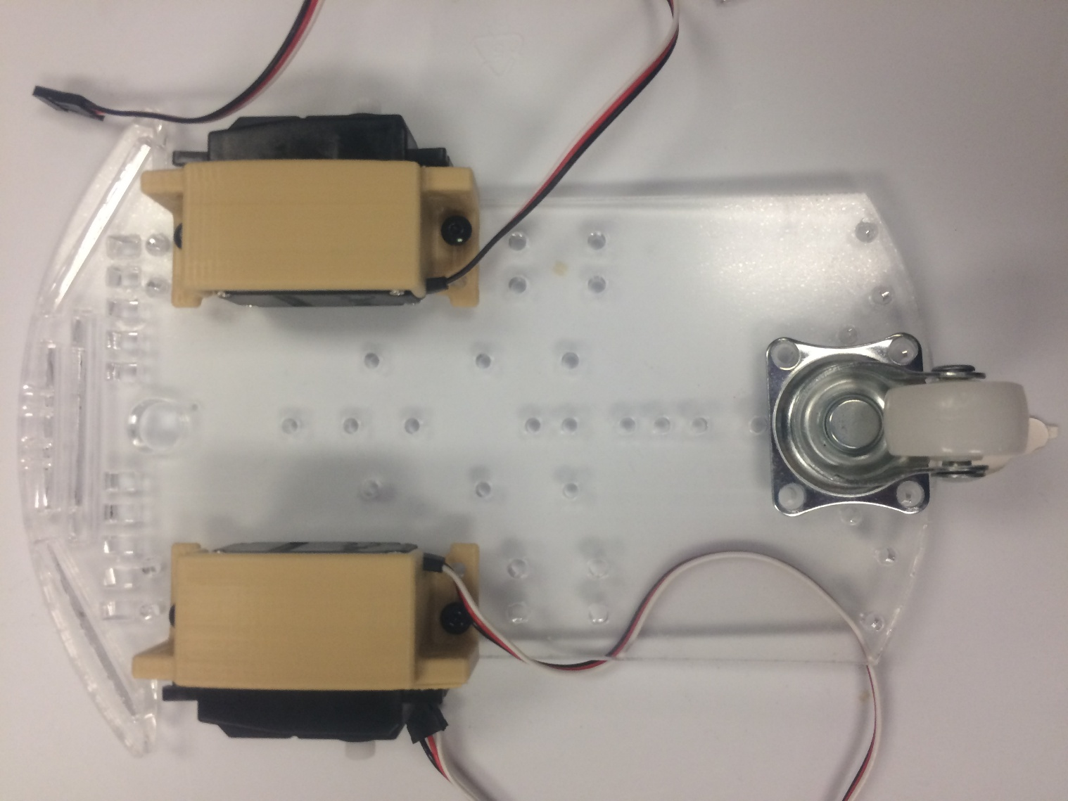
Robot Body Assembly cont’d
5. Here is a picture of the base will all parts on the bottom
At this point, set aside your robot body in a safe place and proceed
to the next set of instructions on how to assemble your Intel
Edison board and its sensors.

Slide 6
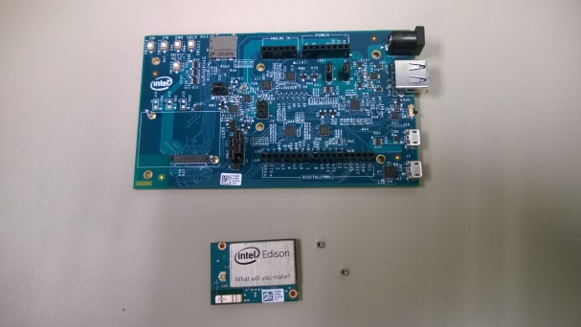
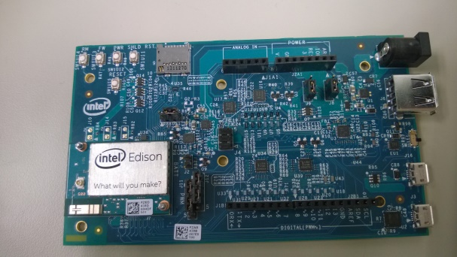
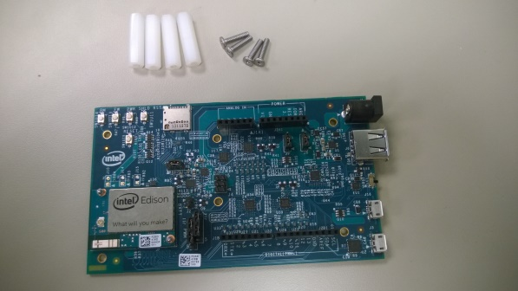
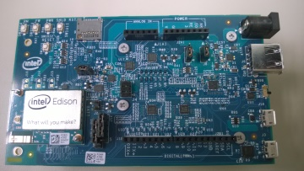
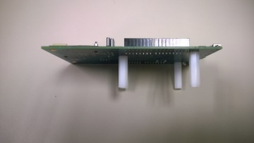
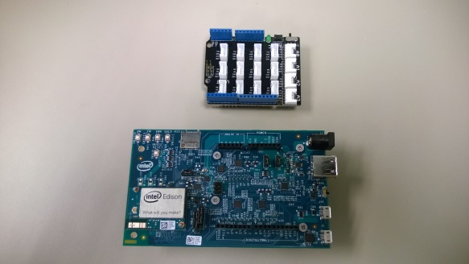
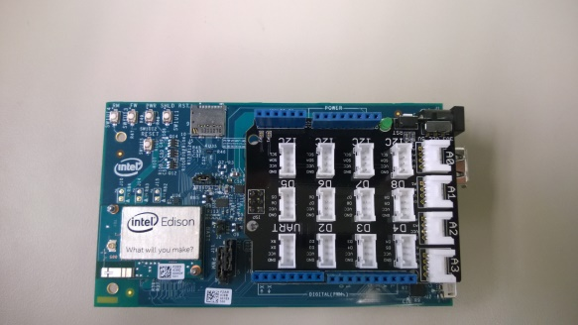
Edison Board/Shield Assembly
1. Gather Edison, breakout
board, and nuts
2. Gently push Edison onto corner
of breakout board
NOTE: You will feel the board secure into place.
After that, gently tighten the nuts to hold it.
3. Gather breakout board and
spacer hardware
4. Place screws as shown through
top of board and screw on spacers
NOTE: Do not over tighten screws, they only need
to be gently snugged against the board.
5. Gather base shield
6. Align pins on shield to ports on
Edison. Gently push down
The screw should go up through the robot base with the nut on the top side of the robot.
NOTE: If shield doesn’t push down, don’t force it. Make sure you have the shield lined up correctly with the board and push until pins are completely inside the ports..

Slide 7
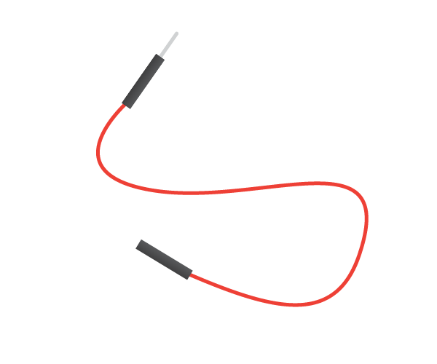

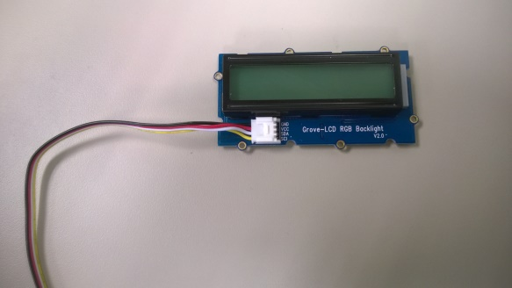
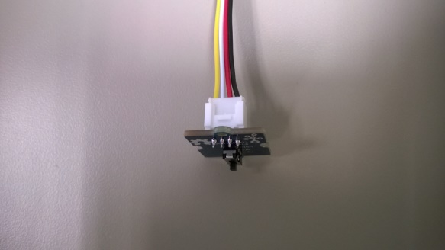
Sensor Assembly
1. Gather sonar sensor and
4- male/Female jumpers
2. Connect a wire to each output pin
3. Gather LCD and female jumper.
Plug jumper into port on LCD
4. Repeat step 3 with other sensors
The jumper will line up with the port so if it
won’t go in, try flipping the jumper.

Slide 8
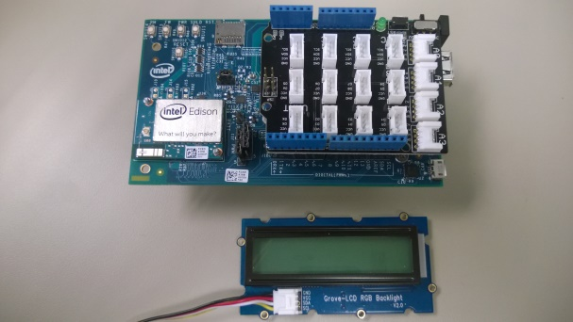
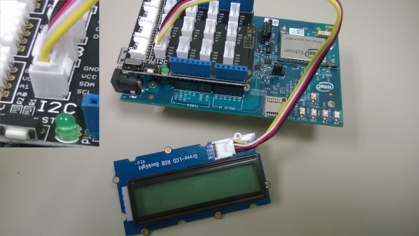
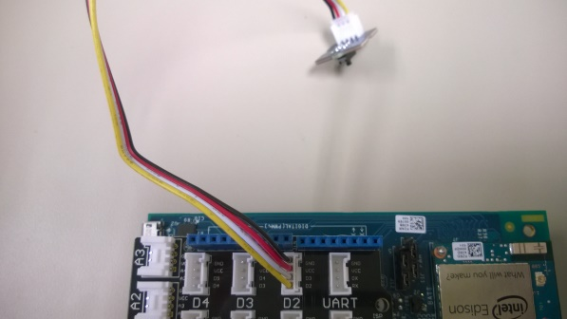
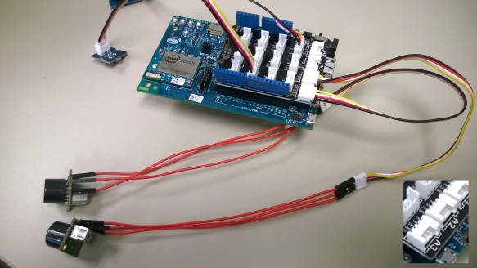
Sensor Assembly cont’d
5. Gather LCD and Edison board
6. Plug LCD into I2C port
Note: For all sensors, servos, and other electronics: Connect RED wire (power) to the power side of the breadboard. Connect BLACK (Ground) to the ground side of the breadboard. The next steps only refer to the signal pins (White).
7. Plug switch signal into
Digital pin 7 (If provided)
8. Plug sonar sensors outputs as follows:
Echo pin in Digital pin 5
Trigger pin in Digital pin 6

Slide 9
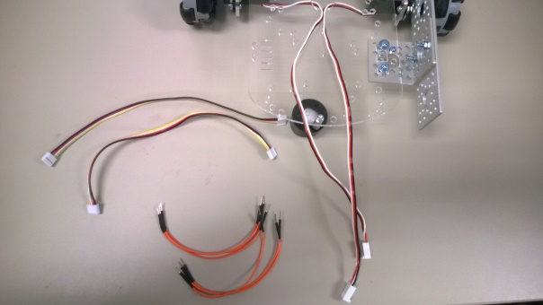
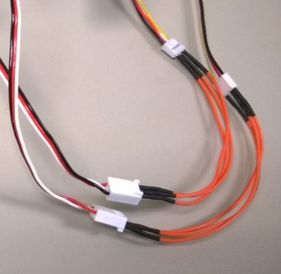
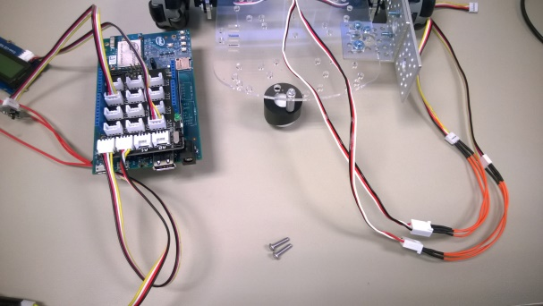
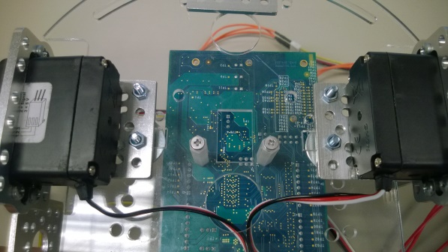
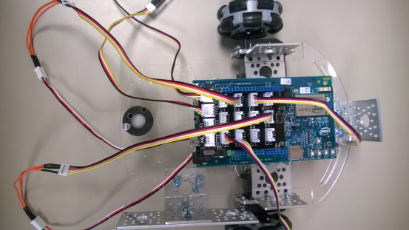
Sensor Assembly cont’d
9. Gather 2- female jumpers,
6- male jumpers, and base
10. Use male jumpers to extend
length of servo cables
MIND THE COLORS: Black to black, red to red,
servo white to female yellow.
11. Gather Edison board and
robot base
12. Attach Edison board to base by
tightening screws into spacers
This is a bottom view of your robot. Make note of
alignment of holes compared to servos.
13. Plug left servo signal into digital port 3
and right signal into digital port 4
14. Connect Edison power
OUT (5V) and GND to Breadboard

Slide 10
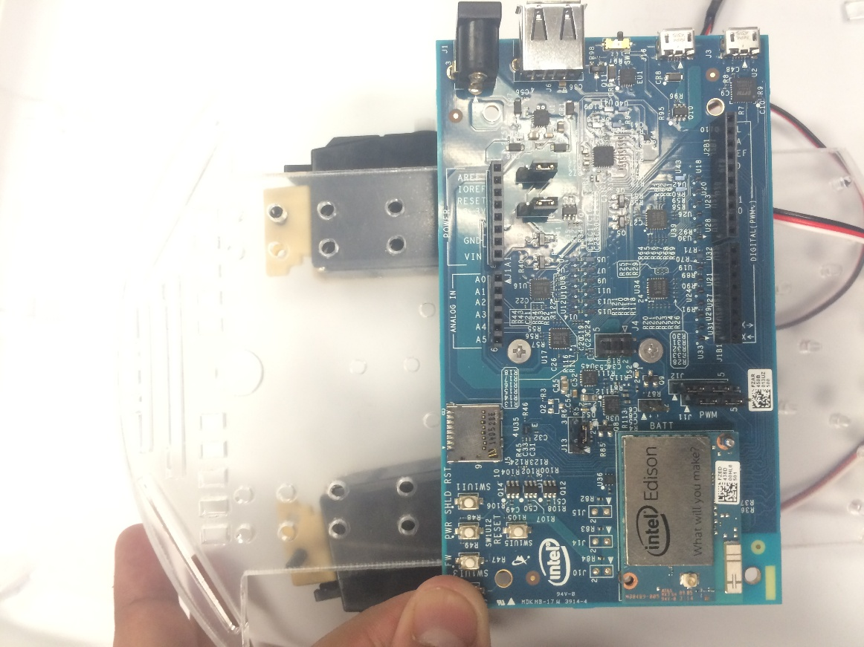

Extra: Edison
Note: Edison Board can be attached in either orientation

Slide 11





Final Assembly
1. Gather robot base, LCD,
Breadboard, and hardware
2. Place breadboard under the Edison
3. Mount LCD Screen to top
4. Attach Sonar mount to front
5. Attach Touch sensor
to front of base
6. Attach custom wires from
sensor to the breadboard

Slide 12



Final Assembly
7. Connect wires from sonar and touch
sensor to the breadboard and Edison
8. Gather external battery
10. Attach Wheels to the servos, and use wheel screw
9. Place battery under the Edison and connect to the microUSB port on the Edison
Congratulations! The hardware is done, now it is time to move
on to programming your robot.

